Slide 1
UCU • Faculty of Engineering, Design & Tech
DSC2107 Project
Steam Top Sellers: Data Mining & Wrangling
Multi-day web scraping, data pipeline engineering, quality restoration, and SQL warehousing of 3,377 Steam market records.
PROJECT TEAM (GROUP 7)
SUBMISSION DATE
Ajak Deng • Aponi Allan • Bulima Ezekiel • Baraka Ishara • Asio
19th October 2026

Slide 2
EXECUTIVE SUMMARY
3,377 RECORDS
Data Mining Pipeline At A Glance
7-Day Extraction
Quality Restoration
Relational Storage
Daily web scraping targeting 500 top-selling titles on Steam (13–19 Oct 2026).
Identified 2,074 missing original prices and recalculated zero-coverage discounts.
Structured loading into MySQL steam_data warehouse for EDA.
Key Takeaway: Merged raw datasets required strict mathematical validation to reconstruct missing discount metrics across 3,377 observational snapshots.

Slide 3
PROJECT FRAMEWORK
Primary & Specific Objectives
1. Automated Scraping & Merging
MAIN GOAL
Collect 7 consecutive daily snapshots and unite them into a consolidated raw dataframe.
End-to-End Data Engineering Pipeline
Automate multi-day collection, cleaning, mathematical transformation, and relational warehousing of live e-commerce game metadata for market insights.
2. Quality Wrangling
Handle null prices, calculate missing discount rates, and isolate true duplicates from multi-day observations.
3. EDA & Ethical Scraping
Target Output: Clean MySQL Table
Generate visual trends while strictly respecting web server access policies and user-agent guidelines.
Group 7 • DSC2107 Project Objectives

Slide 4
METHODOLOGY
Technology Stack & Technical Architecture
Extraction
Wrangling
Storage
Analysis
Requests & BS4
Pandas & Jupyter
MySQL Workbench
Matplotlib / Seaborn
Python HTTP requests & HTML parsing targeting Steam Top Sellers pages.
Data merging, null auditing, deduplication, and formula calculations.
Relational schema storage inside database steam_data.
Visualization charts for price distribution and rating patterns.
DATA PIPELINE SEQUENCE
HTML Response
7x Daily CSVs
pd.concat()
Wrangling Engine
MySQL Import

Slide 5
DATA ACQUISITION
Target Deficit: -123 Records
Daily Extraction Record Yield
13 Oct 2026
500
14 Oct 2026
500
15 Oct 2026
500
16 Oct 2026
500
17 Oct 2026
377
18 Oct 2026
500
19 Oct 2026
500
Note: Six runs met the 500-record capacity. Network interruptions on 17 October led to a shortened capture of 377 rows, generating a total raw dataset of 3,377 records instead of 3,500.

Slide 6
DATA QUALITY AUDIT
Pre-Cleaning Missing Value Inspection
Column Name | Available Records | Missing Records | Null Proportion | Audit Notes
price | 3,368 | 9 | 0.27% | Unlisted or unpriced promotional titles
original_price | 1,303 | 2,074 | 61.41% | Missing for non-discounted full price titles
discount_percent | 0 | 3,377 | 100.00% | Raw column totally unpopulated in html extract
review_summary | 3,274 | 103 | 3.05% | Unreviewed or newly released games
Critical Finding: discount_percent suffered 100% data absence at scrape time, requiring synthetic programmatic reconstruction from price fields.

Slide 7


DATA TRANSFORMATION
Algorithmic Reconstitution of Discounts
1. Filter Boundary Conditions
MATHEMATICAL FORMULA
Excludes free-to-play ($0) items and missing prices to prevent zero-division runtime errors.
2. Preserve Null Distinction
Executed exclusively when Price_orig > 0 and valid numeric pairs exist.
Non-discounted games are left as explicit NULLs rather than assumed 0% to avoid skewed distribution averages.
Example Execution: $100 Original → $75 Current
Calculated Result: 25.0% Discount

Slide 8
VALIDATION LOGIC
Exact Duplicates vs Longitudinal Observations
Removed: Identical Records
Retained: Longitudinal Ranks
Rows possessing identical attributes, timestamps, and game IDs scraped during duplicate execution passes were systematically dropped.
Same-game entries appearing across different dates were explicitly retained to track daily price and sales rank fluctuations.
df.drop_duplicates(inplace=True)
// Preserved for Time-Series Analysis
Validation Rules Applied: No negative prices • Verified AppIDs • ISO 8601 Timestamps
Data Integrity: PASS

Slide 9

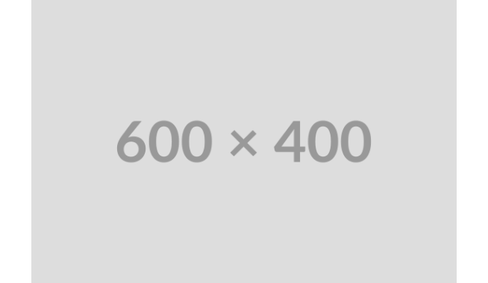
EXPLORATORY DATA ANALYSIS
Price Distribution Across Categories
Low-Price Dominance
Concentrated spikes under $20 indicate top sellers are heavily driven by budget titles.
Genre Price Variance
Singleplayer and Action games showcase wider density tails extending up to $60–$70.
Source Data: Figure 2 (Report Dataset)
EDA Finding 01

Slide 10

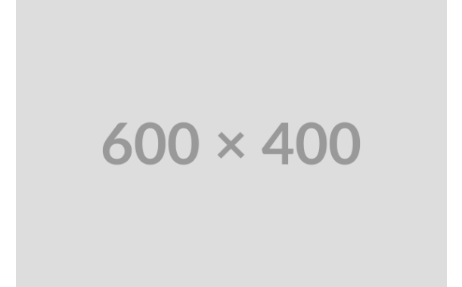
MARKET STRUCTURE
Monetization Model Breakdown
86.6%
Paid Games Representation
Premium upfront titles dominate Steam's Top Seller revenue rankings.
13.4%
Free-to-Play Titles
451 raw records maintained high rankings via microtransactions.
Research Insight: Though fewer in title counts, Free-to-Play games persistently hold top 10 positions due to high concurrent player engagement.

Slide 11
PROMOTIONAL DYNAMICS
Discount Percentage Distribution
50% Discount Clustering
The single largest promotional peak occurs at exactly 50% off standard pricing.
75% Deep Markdown Peak
Secondary clustering at 75% marks aggressive publisher clearance strategies.
Source Data: Figure 5 (Calculated Discounts)
EDA Finding 03

Slide 12
TIME-SERIES ANALYSIS
Average Daily Price Fluctuations
17 Oct Price Spike
Singleplayer titles surged past $32 average price due to high-tier AAA games entering top ranks.
Action & Adventure Stability
Action/Adventure categories maintained flat averages between $21 and $23 throughout the week.
Source Data: Figure 3 (7-Day Trend)
EDA Finding 04

Slide 13
DATABASE ENGINEERING
MySQL Warehousing & Verification Queries
-- Target Database & Table Creation
-- Discount Population Audit Query
CREATE DATABASE steam_data;
SELECT
USE steam_data;
COUNT(*) AS total_records,
COUNT(discount_percent) AS discounted,
-- Integrity Record Verification
SUM(discount_percent IS NULL) AS standard
SELECT COUNT(*) AS total_records
FROM steam_top_sellers_cleaned;
FROM steam_top_sellers_cleaned;
MySQL Table: steam_top_sellers_cleaned
Verification Script Ready

Slide 14
PROJECT EVALUATION
Engineering Challenges & Best Practices
Challenges Encountered
Strategic Recommendations
•
DNS Resolution Failures: Connection breaks during store.steampowered.com requests.
•
Automated Retries: Implement exponential backoff for HTTP scraper resilience.
•
Data Capture Loss: 17 Oct run dropped 123 rows due to early network timeouts.
•
Preserve Raw Files: Keep original CSV outputs to allow lineage auditing.
•
Unique Game ID Normalization: Isolate daily observations from unique game counts during EDA.
•
Empty Scraped Attributes: Raw discount columns required complete programmatic calculation.
Responsible Scraping Adherence: Complied with User-Agent and request frequency throttling rules.

Slide 15
Project Conclusion
Thank You! Questions?
Steam Top Sellers Data Mining & Wrangling Report • Group 7
UCU DSC2107
MySQL: steam_data

